Slide 1
'No known antidote': Paraquat and its domestic users in Britain
Catherine Rushmore
PhD student
Oxford Brookes University
Science Museum

Slide 2
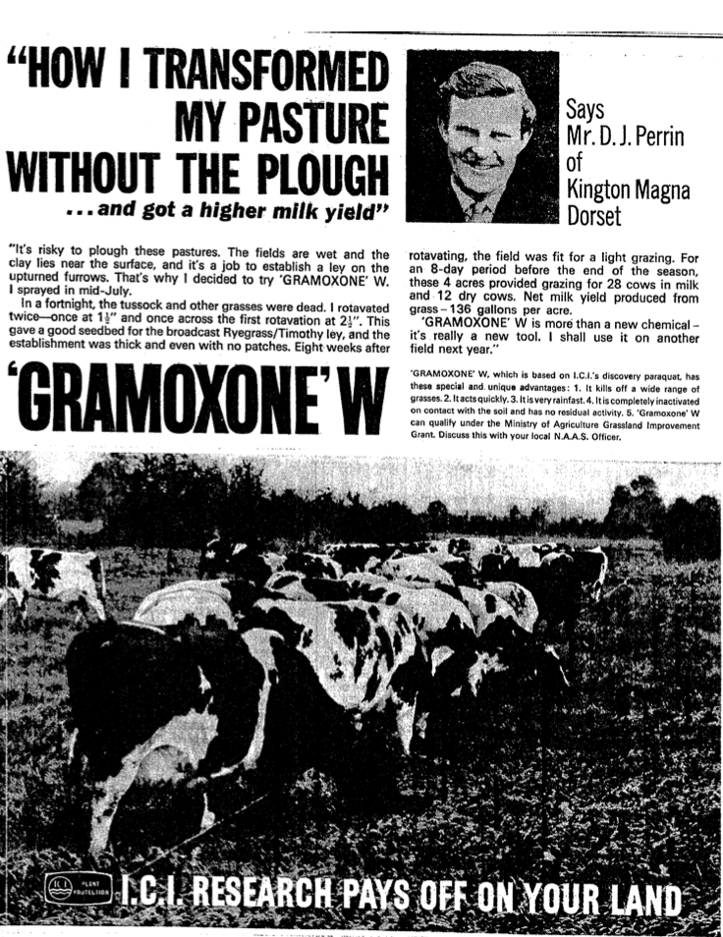
ICI, display ad,
The Times,
p. ii, 07 Dec. 1964

Slide 3
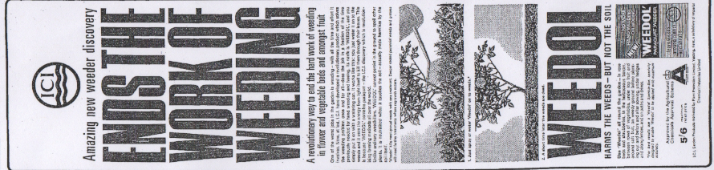

Display Ad
Daily Express and Daily Mirror
April 1965

Slide 4
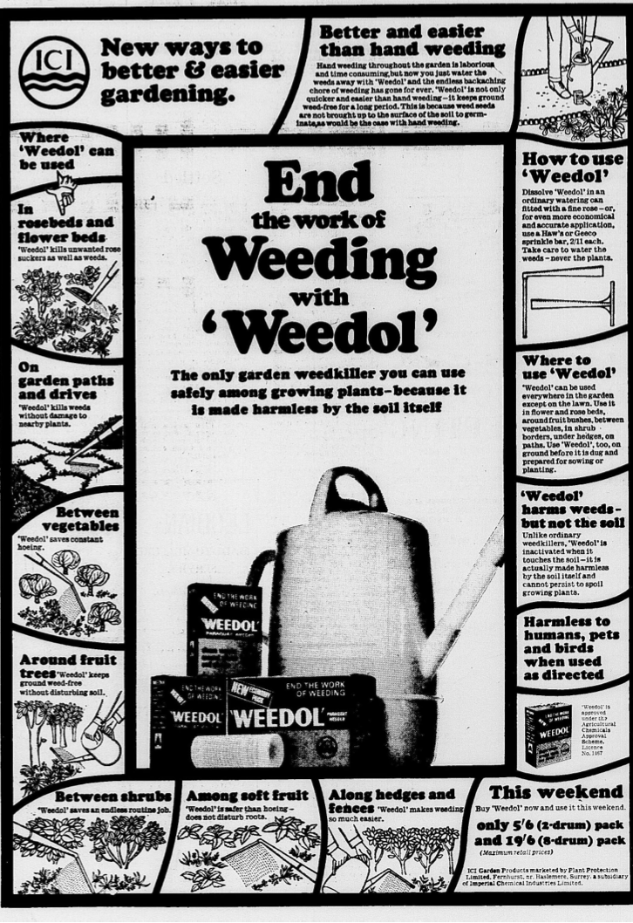
1966
display ad
Daily Mail
April

Slide 5
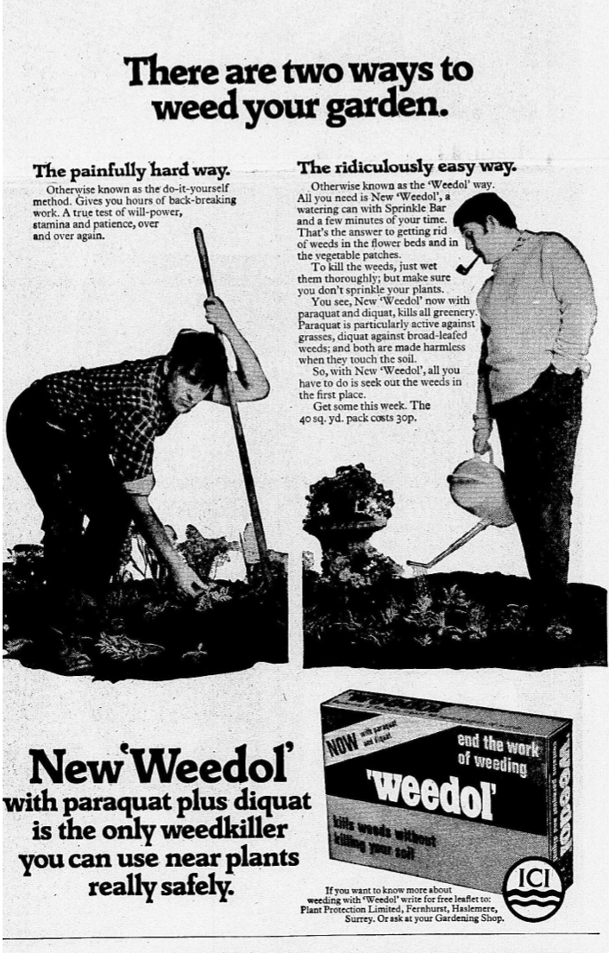
1971
Display ad,
The Daily Mail
April

Slide 6
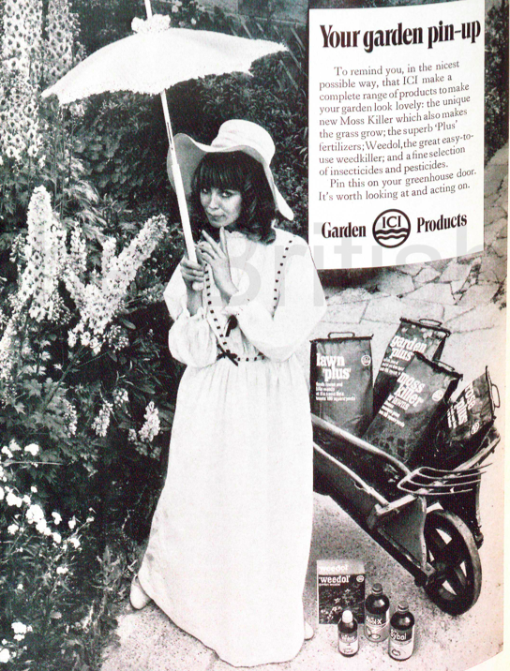
1970
Amateur Gardening
Annual

Slide 7
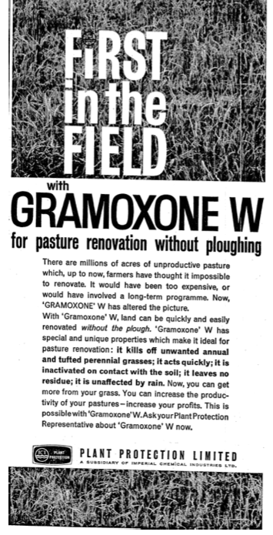
ICI, display ad
The Times
p. v. 02 Dec.
1963

Slide 8
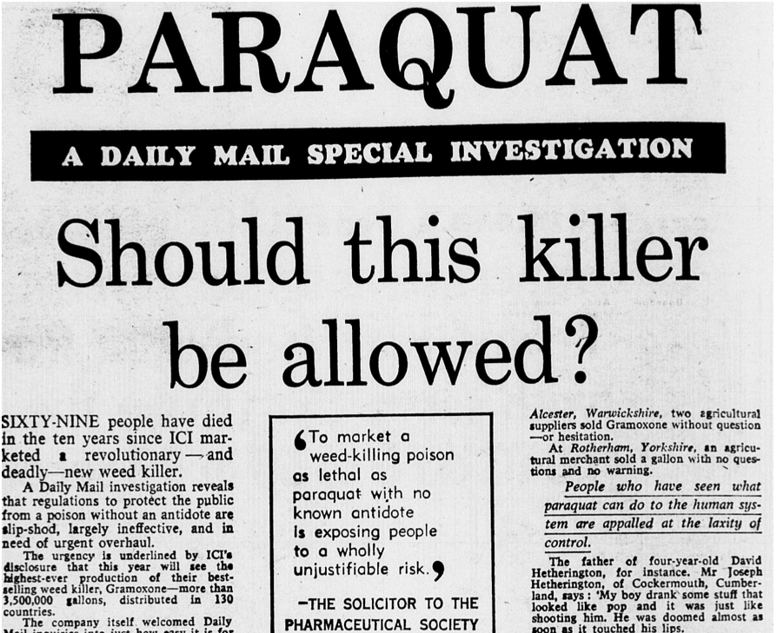
Daily Mail
30 Aug.
1972
p.6

